Slide 1





Come Worship With Us!
Connect Groups at 9:30 AM
Worship Service at 10:45 AM
Sunday Evenings at 6:00 PM

Slide 2


About Us
Adult Ministry
Children’s Ministry
Awana
King’s Kids
Toddler Time
Come Worship With Us!
Youth Impact
Connect Groups at 9:30 AM
Worship Service at 10:45 AM
Sunday Evenings at 6:00 PM

Slide 3

x
Sunday Evening Events Cancelled Due to Inclement Weather.
Be safe, we’ll see you next week!
Come Worship With Us!
Connect Groups at 9:30 AM
Worship Service at 10:45 AM
Sunday Evenings at 6:00 PM

Slide 4

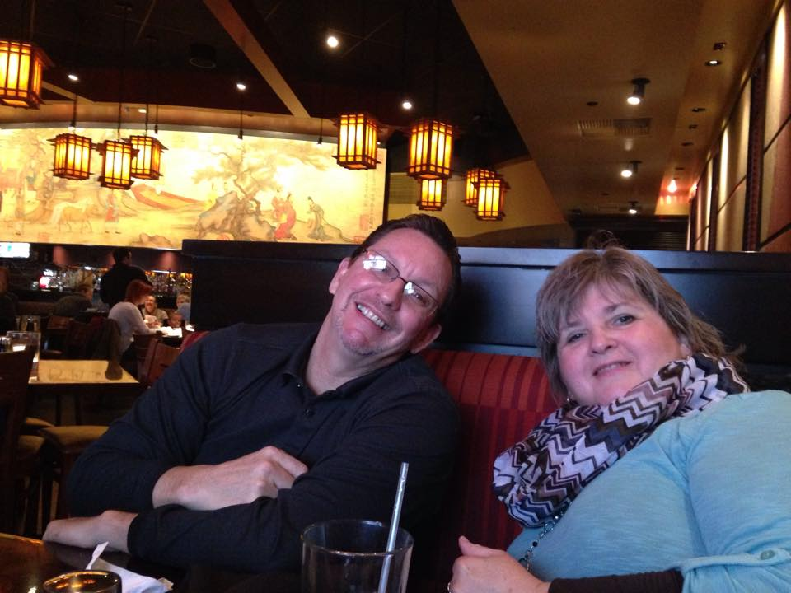
Pastor Steve Fehrman
Pastor Steve serves Southern Calvert as the Senior Pastor. He has served at SCBC since 2007. Pastor Steve loves fishing, landscaping, and theology. He is passionate about following the Lord Jesus Christ. Pastor Steve's goal is to see people come to faith in Christ and grow to full maturity in Him.

Slide 5
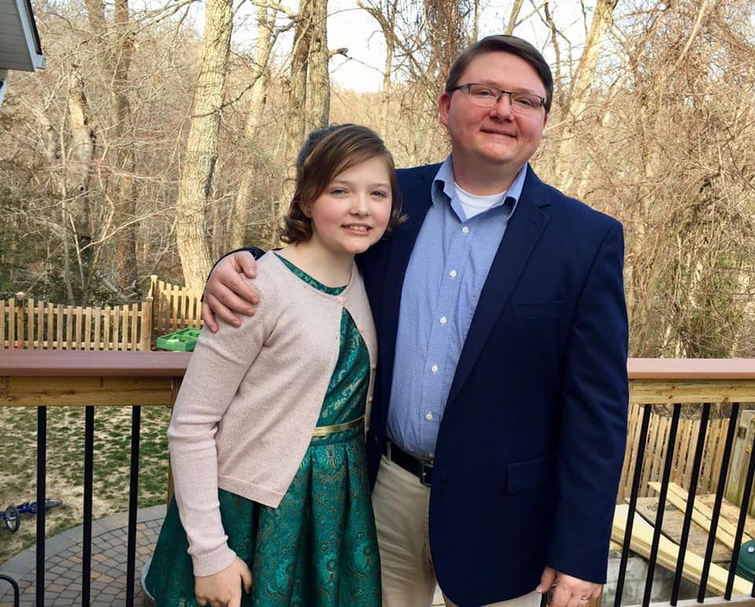
Pastor Erik Brewer
Pastor Erik serves Southern Calvert as the Associate Pastor of Outreach, Assimilation, and Discipleship. He has served at SCBC since August of 2017. Pastor Erik is a born-again Christian who has a passion to know the Lord Jesus Christ. He served as a missionary on the foreign mission field for more than 8 years. Erik loves to use his spiritual gift of teaching. Discipleship is the central focus of his life. He enjoys teaching Bible studies in many different forms, through ESL, computers, simple studies, and sports.

Slide 6
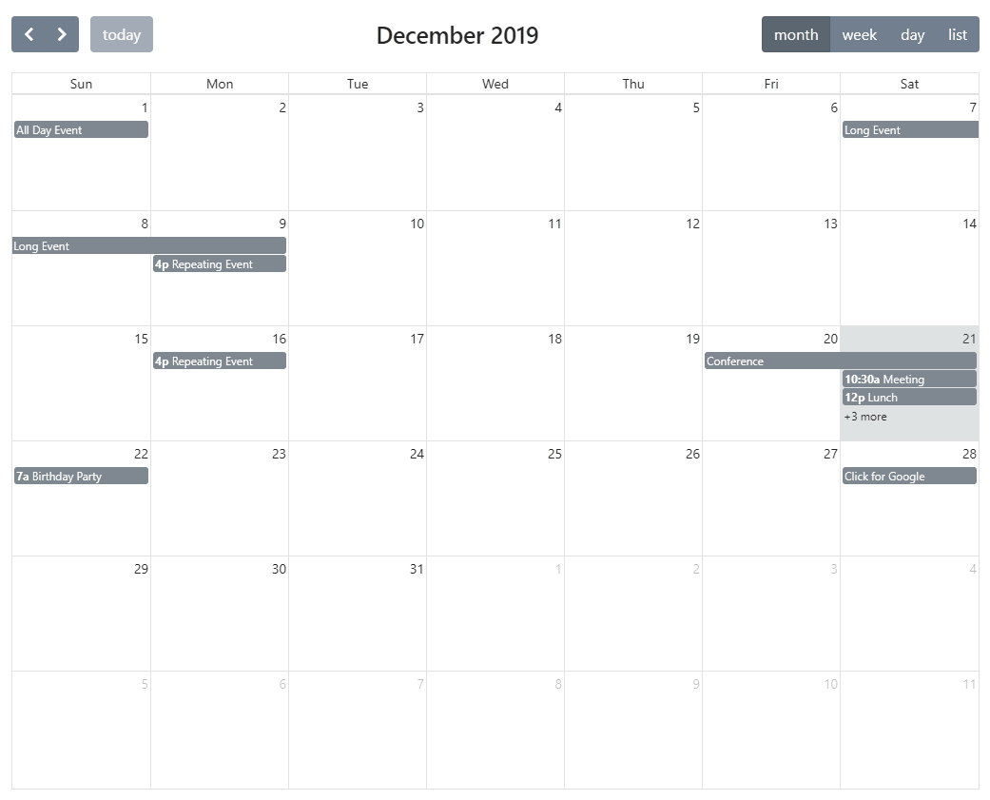
Southern Calvert Baptist Church Event Calendar

Slide 7
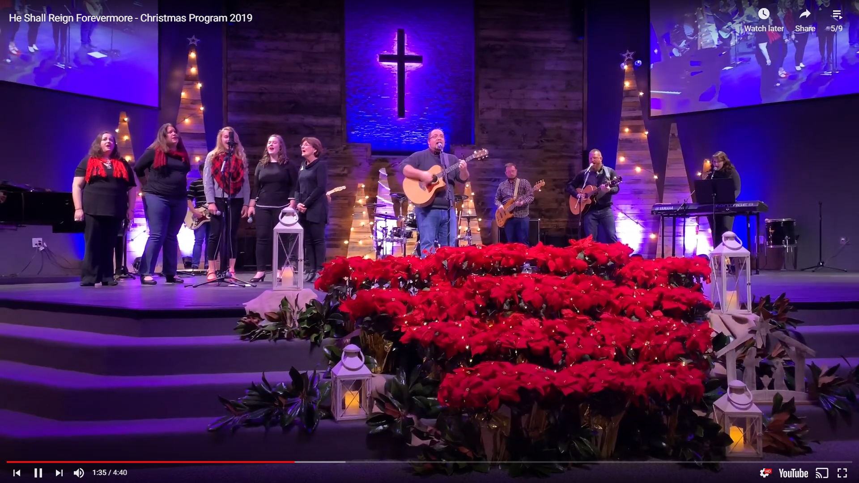
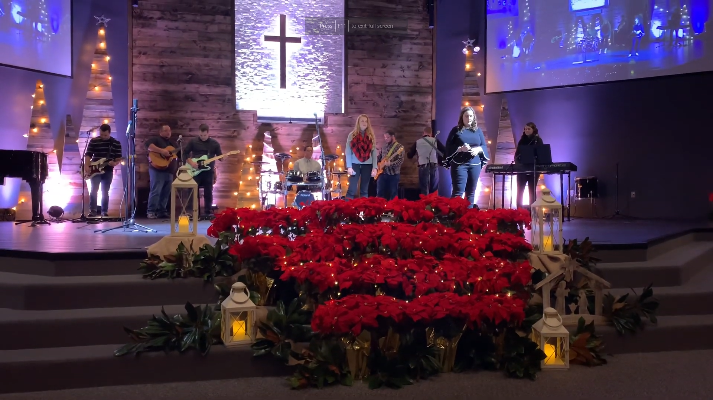
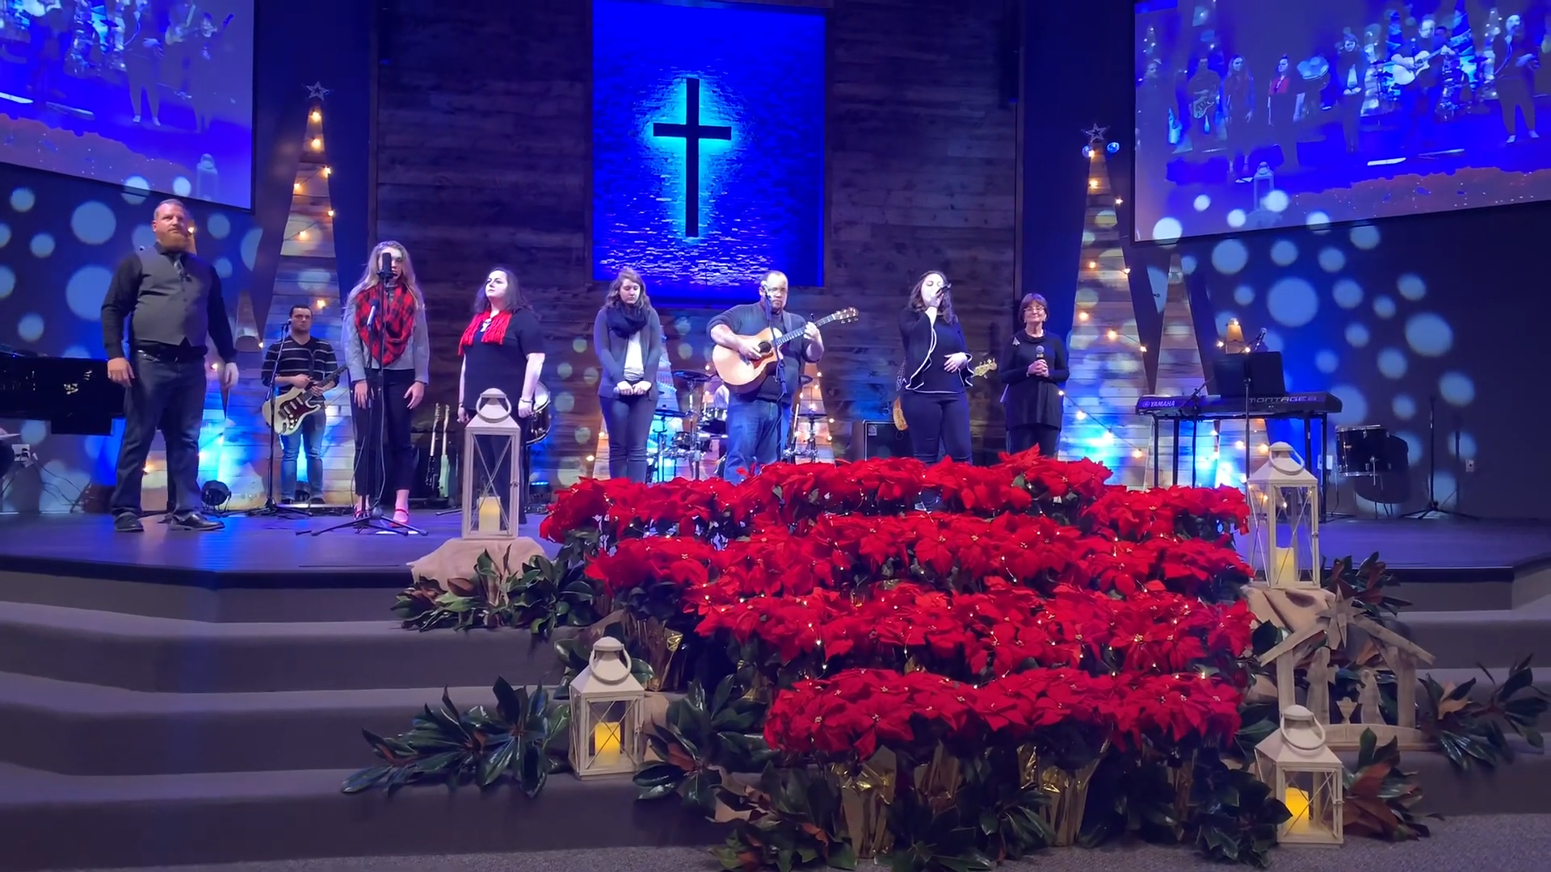
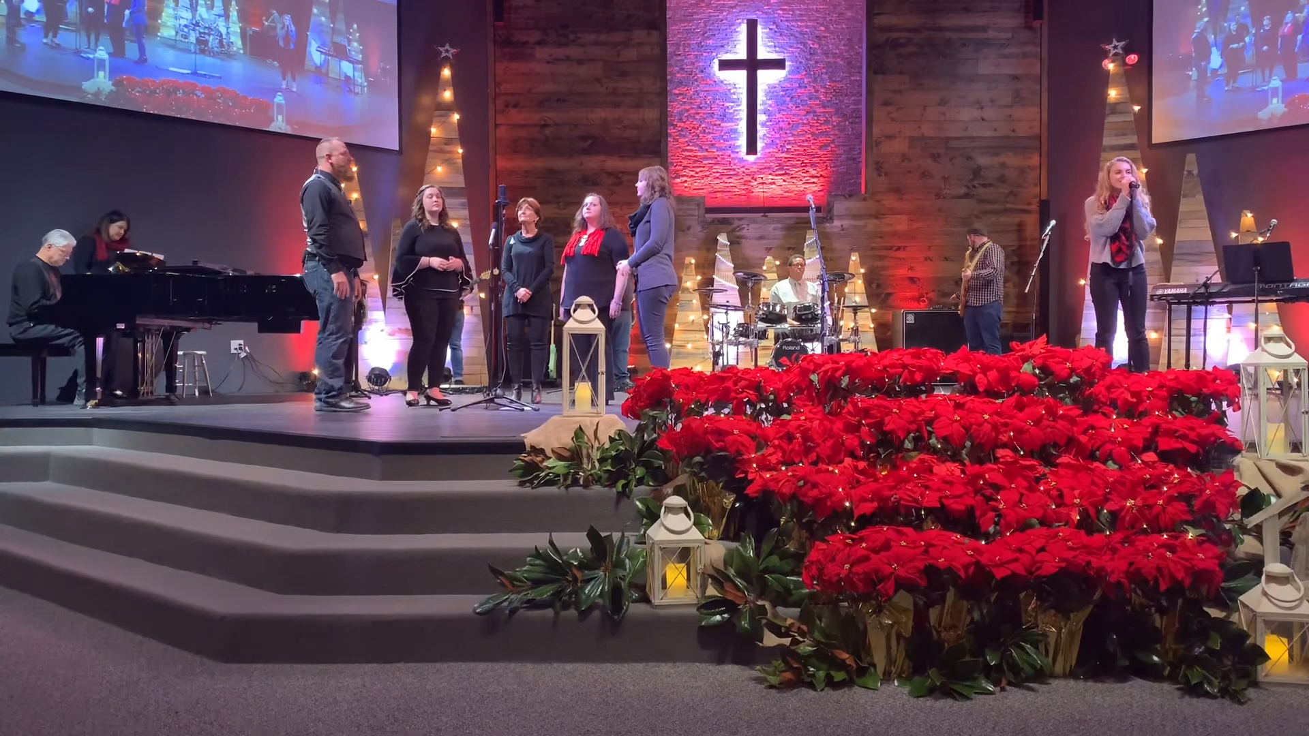
Southern Calvert Baptist Worship Services
Noel – Christmas Program 2019
Oh Holy Night – Christmas Program 2019
He Shall Reign Forevermore – Christmas Program 2019
God Rest Ye Merry Gentlemen – Christmas Program 2019

Slide 8
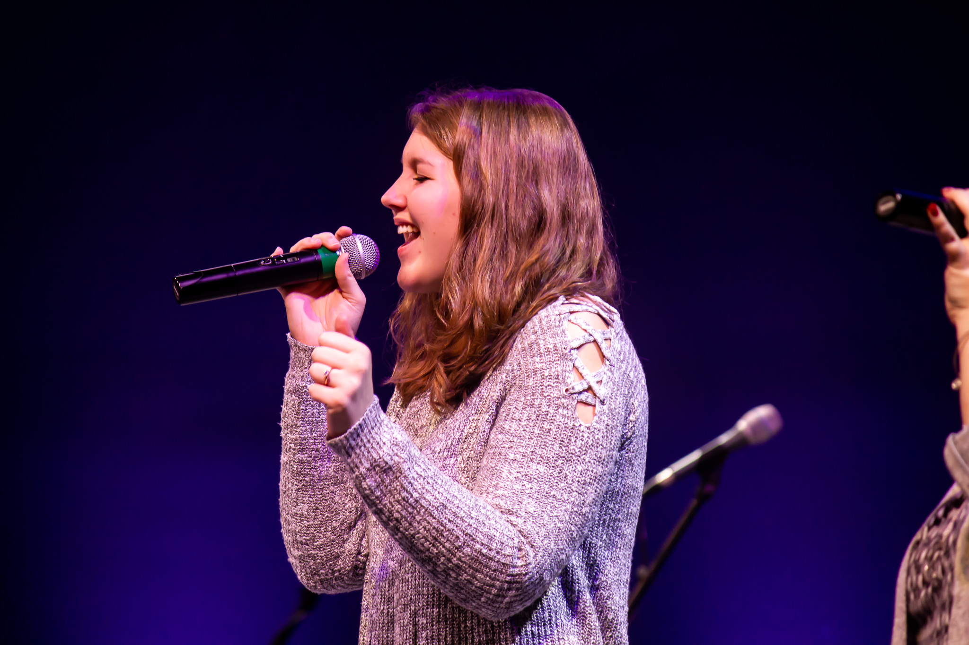
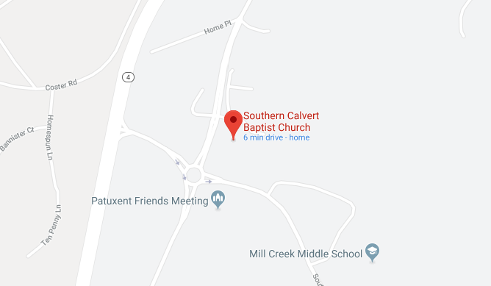
Contact Us
410-326-6533
scbc1secretary@gmail.com
Sunday Worship Service at 10:45 AM
12140 H G Trueman Rd, Lusby, MD 20657
Get Connected | Southern Baptist Convention | Give Online | Watch Sermon | Livestream
Copyright © 2019 Southern Calvert Baptist Church. All Rights Reserved

